Slide 1


Talleres rodriguez
Authors:
Francisco Javier Rojo Martín
Manuel Menor Flores
Víctor Manuel Álvarez Redondo

Slide 2

INDEX
Information about Talleres Rodriguez
what have they requested?
Software Development
Case use Diagrams
Class Diagram
Sequence Diagrams
State Diagrams
Activity Diagram
Interface
Handbooks
User Manual
Programmer’s Manual

Slide 3
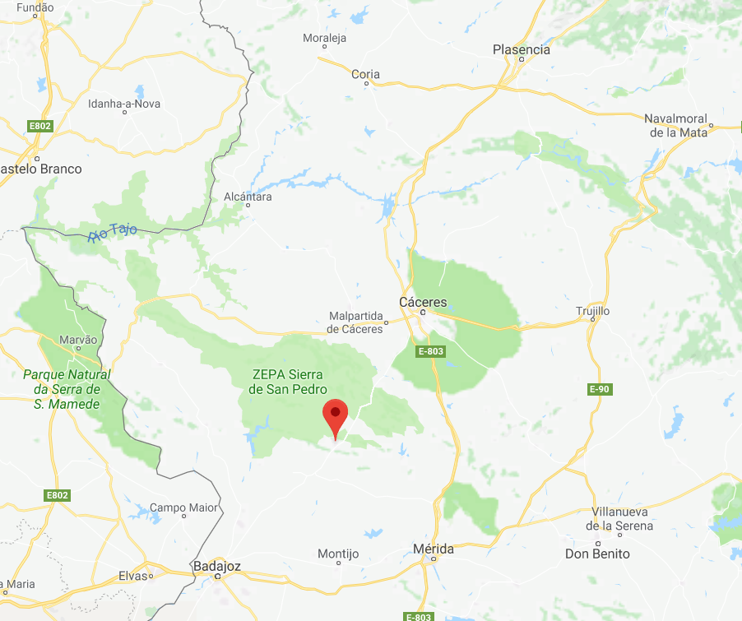

Information about Talleres Rodriguez
Talleres Rodriguez
Puebla de Obando (Badajoz)
Small mechanical workshop
Two members: boss and partner

Slide 4



Information about Talleres Rodriguez
Main services:
repair agricultural vehicles
home repair
repair in mechanical workshop

Slide 5

what have they requested?
Automate business model:
Client manager
Repair manager
Invoice manager
stock manager
...

Slide 6

Software Development- Phases
Information gathering:
Documentation gathering
Interview with the boss
Dialogue with the members of the company to solve doubts
Analysis of the information obtained
Design of the system to be developed
Design and development of interface

Slide 7
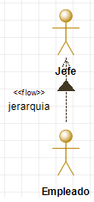
Software Development - information analysis
Use Case Diagrams
It allow us know differents functionalities of the system
Two actors: Jefe and Empleado
Actors hierarchy
We have divided diagrams by managers

Slide 8
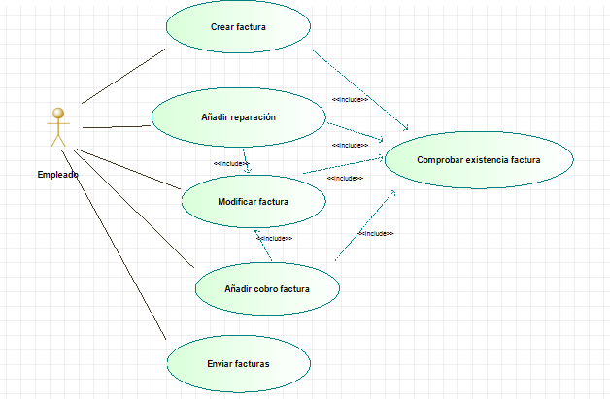
Software Development - information analysis
Use Case Diagrams - Example
Invoice manager

Slide 9
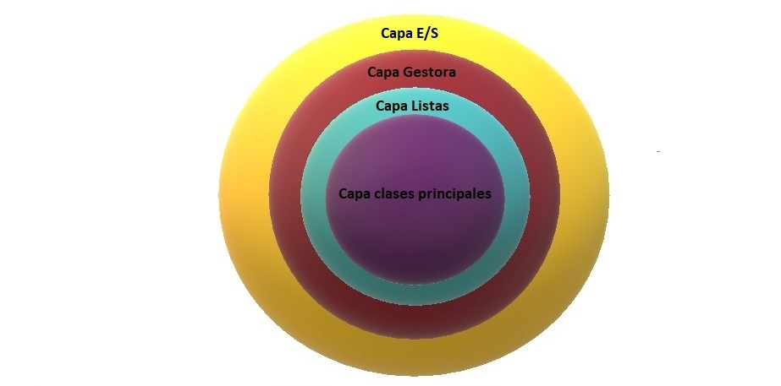
Software Development - System Design
Class Diagram
It facilitates understanding of the structure of the system
show attributes and operation of objects and their visibility

Slide 10
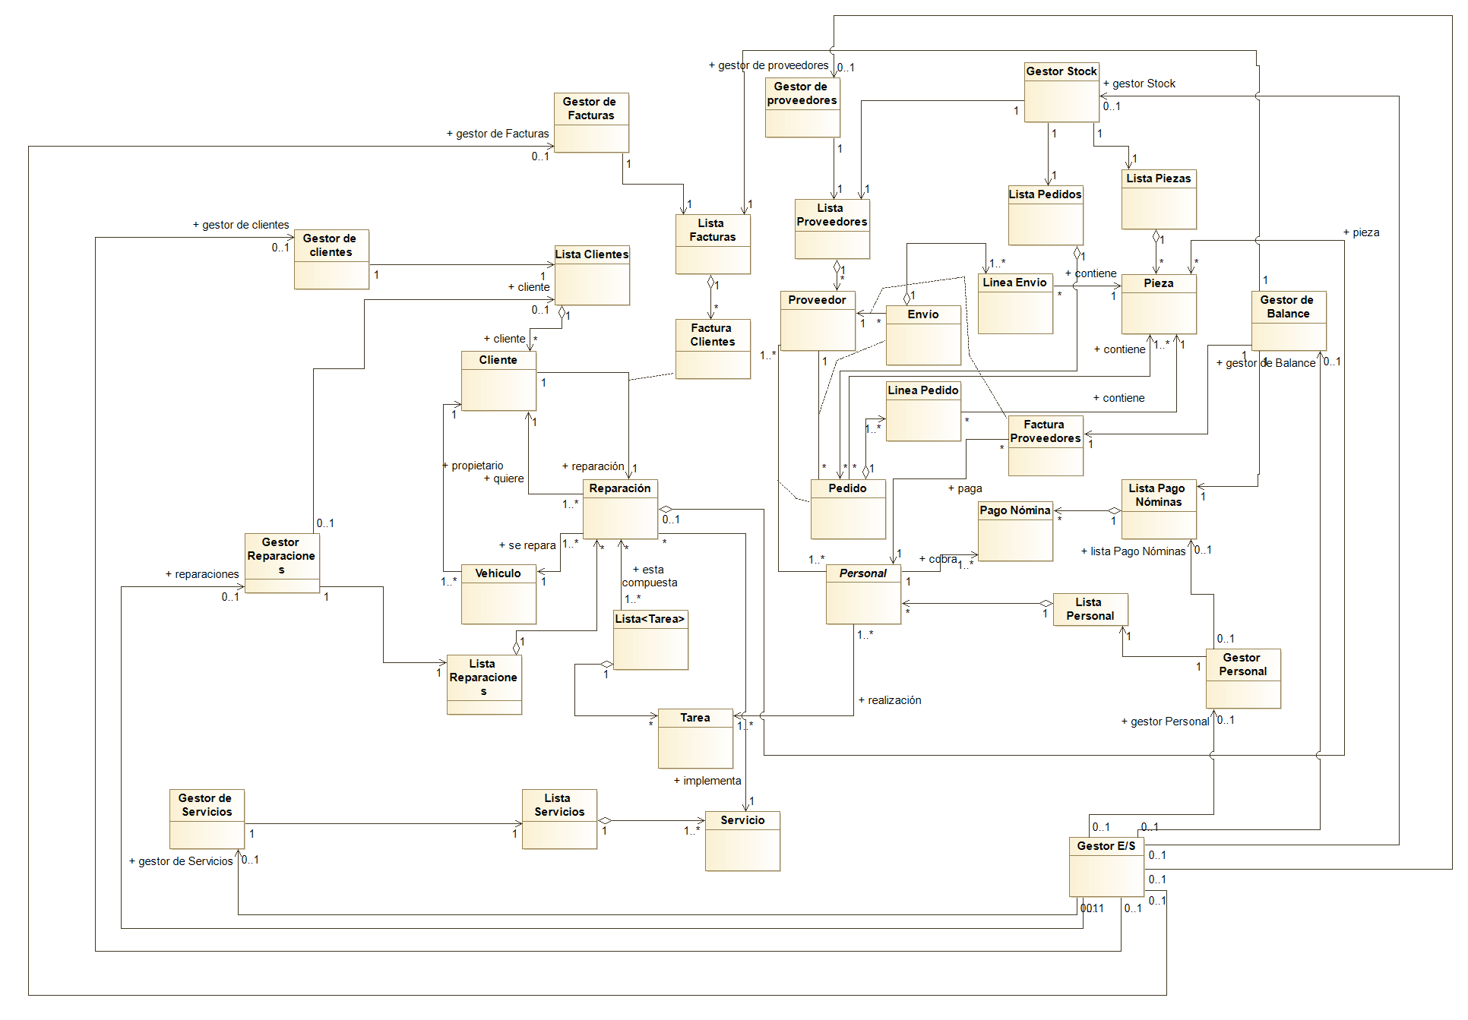

Slide 11
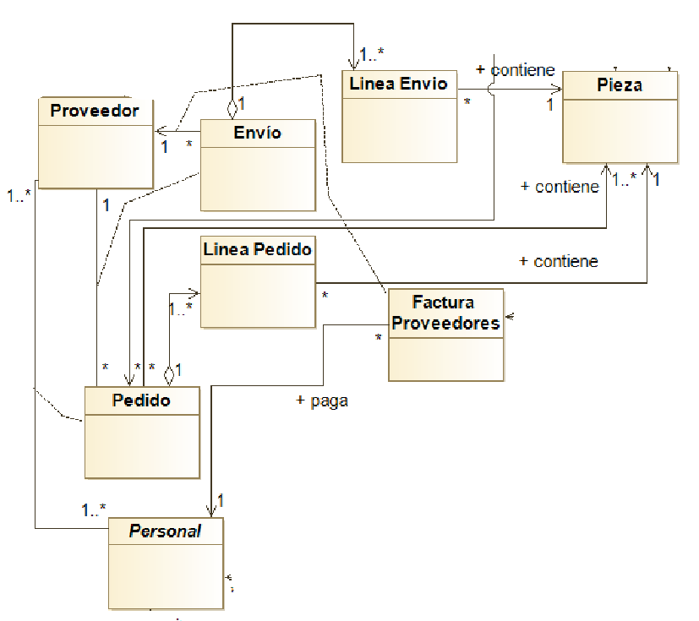
Software Development - System Design
Class Diagram - Stock Manager
Little fragment of
the class diagram

Slide 12
Software Development - System Design
Sequence Diagrams
In order to show behaviour of use cases
4 Sequence Diagrams:
Añadir reparación (Add reparation)
Consultar stock (Consult stock)
Imprimir folleto (print brochure)
Modificar pago nomina (modify payment pay-roll)

Slide 13
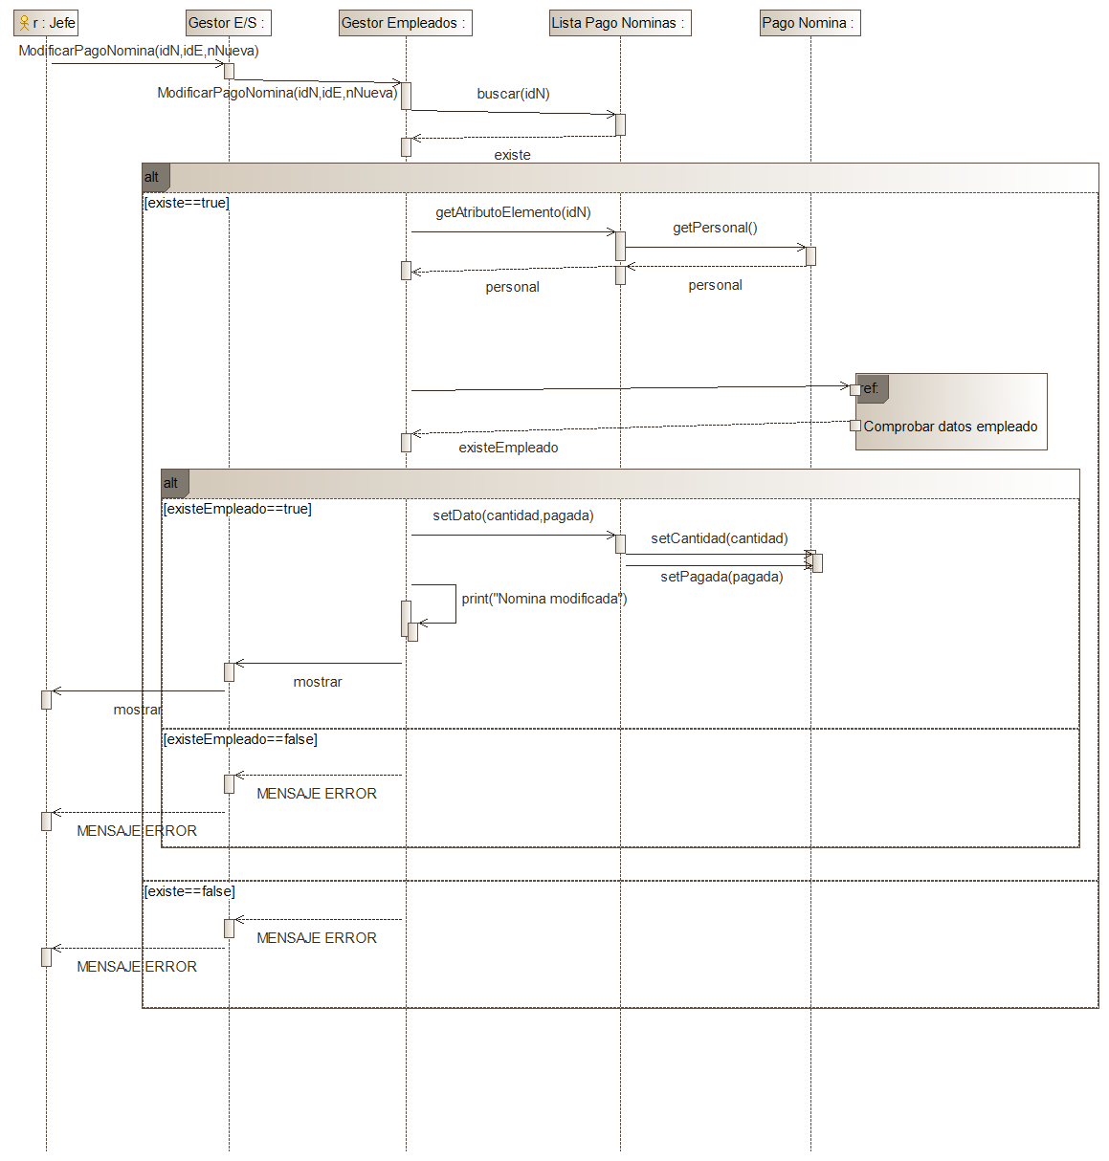

Slide 14
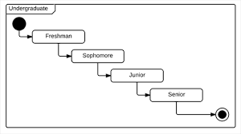
Software Development - System Design
State Diagrams
Show all states of objects (not use cases) during its life
It describes how events affect to objects

Slide 15
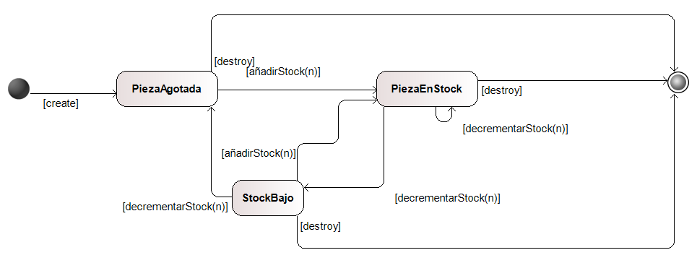
Software Development - System Design
State Diagrams

Slide 16
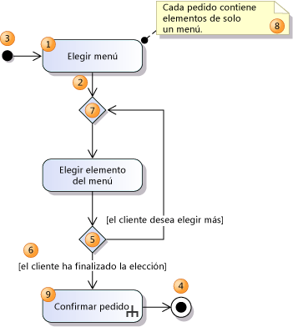
Software Development - System Design
Activity Diagram
Symbolize action states
To synchronize concurrent operations of one or various use cases

Slide 17
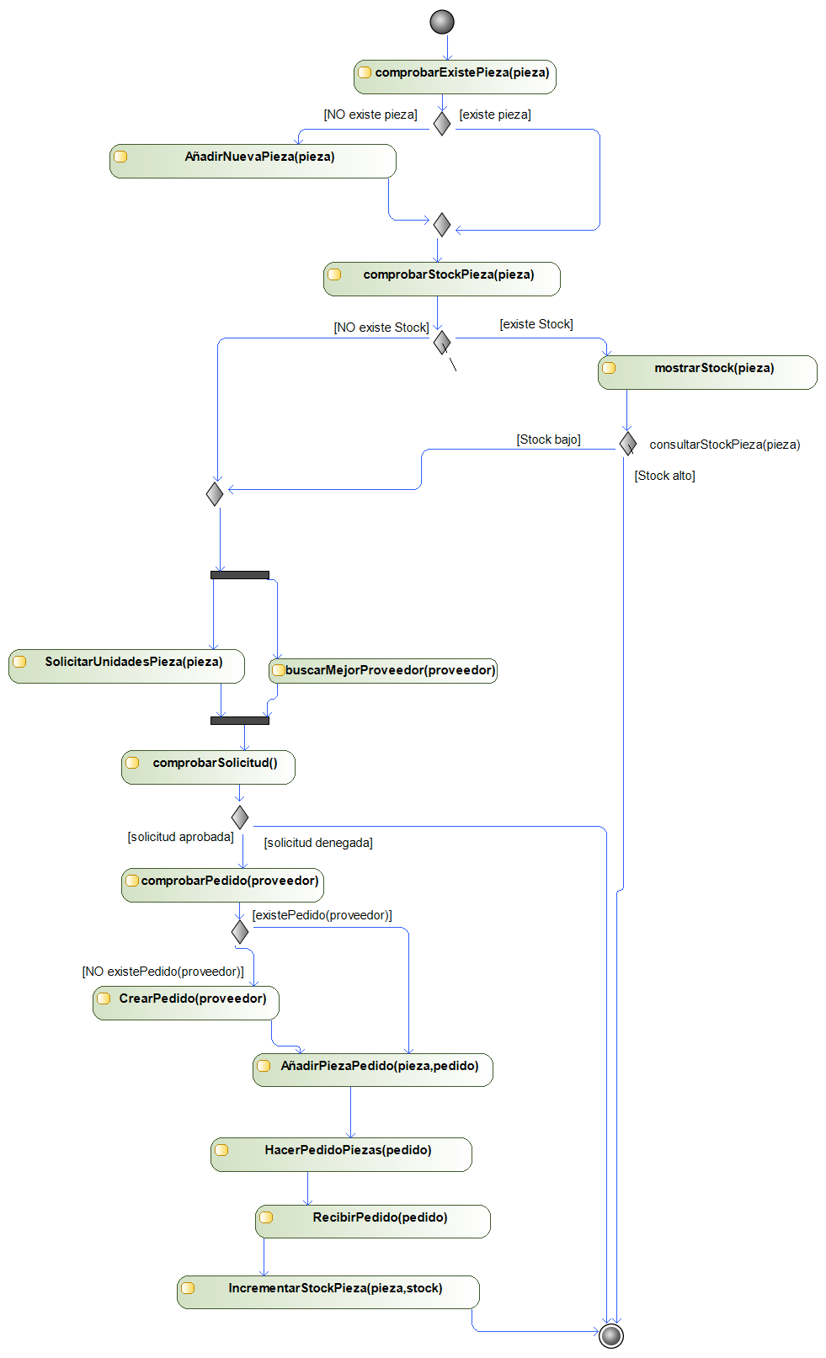

Slide 18
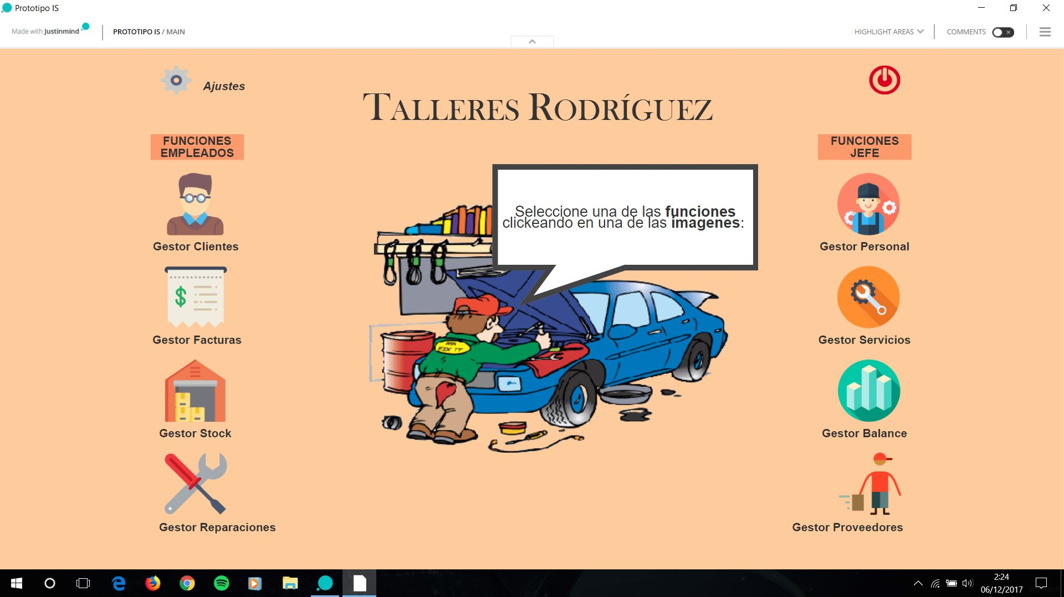
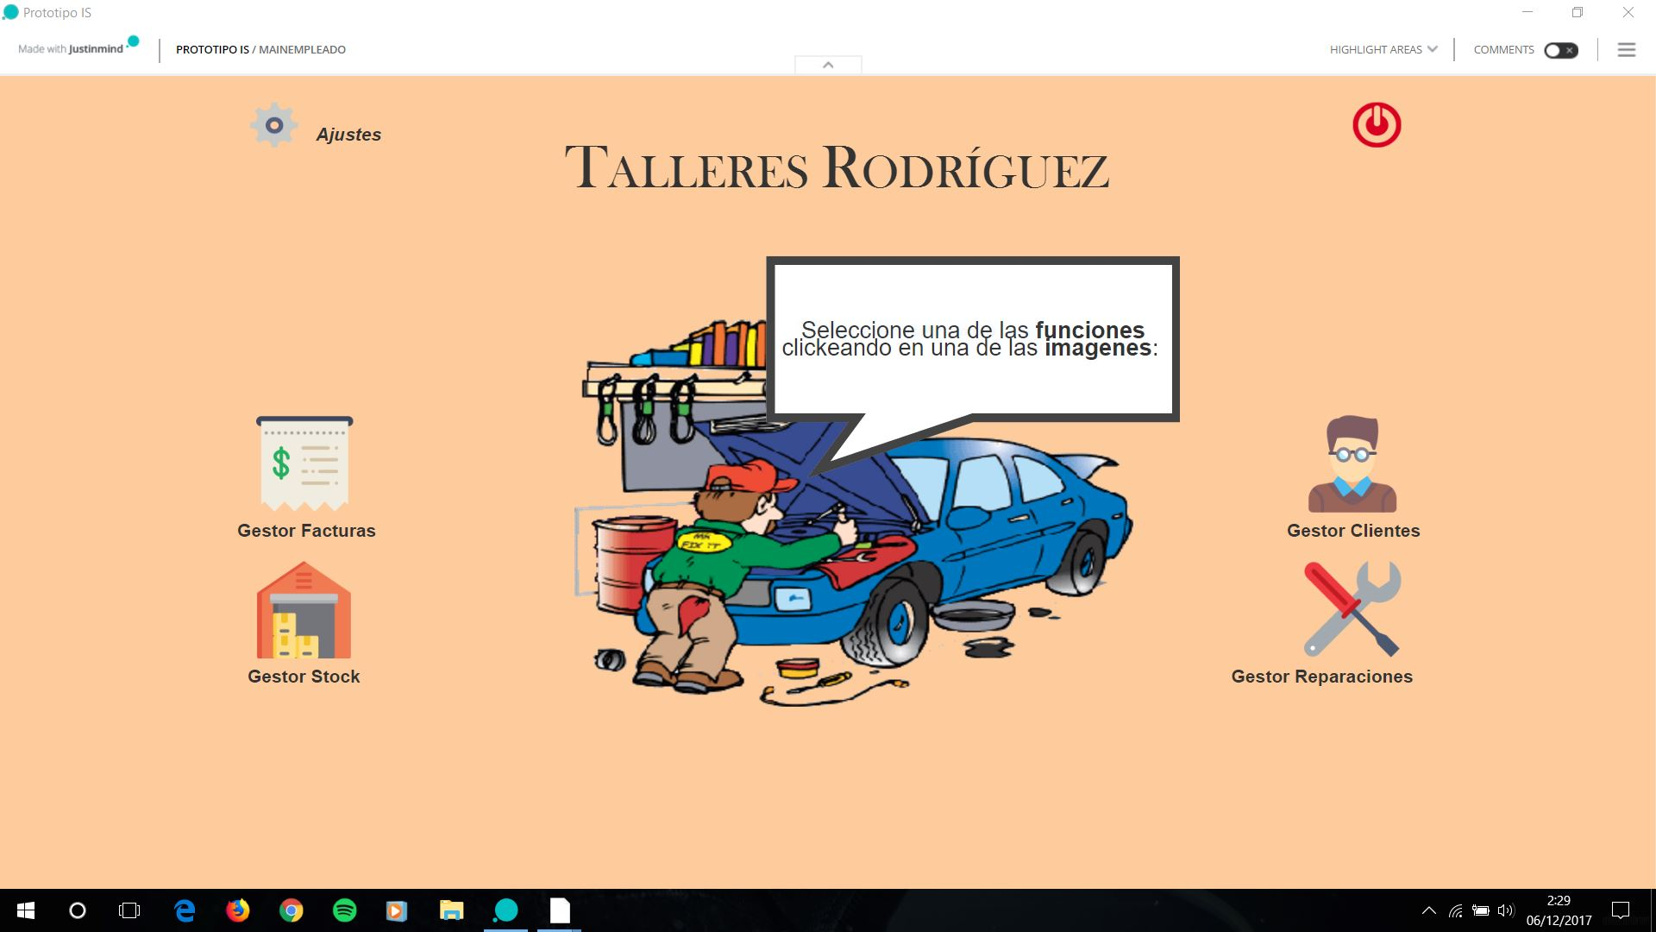
Sotfware Development - Interface
Interface without functionality
Developed with “JustinMind”
Desktop application
We can execute with HTML code
Screenshots:

Slide 19
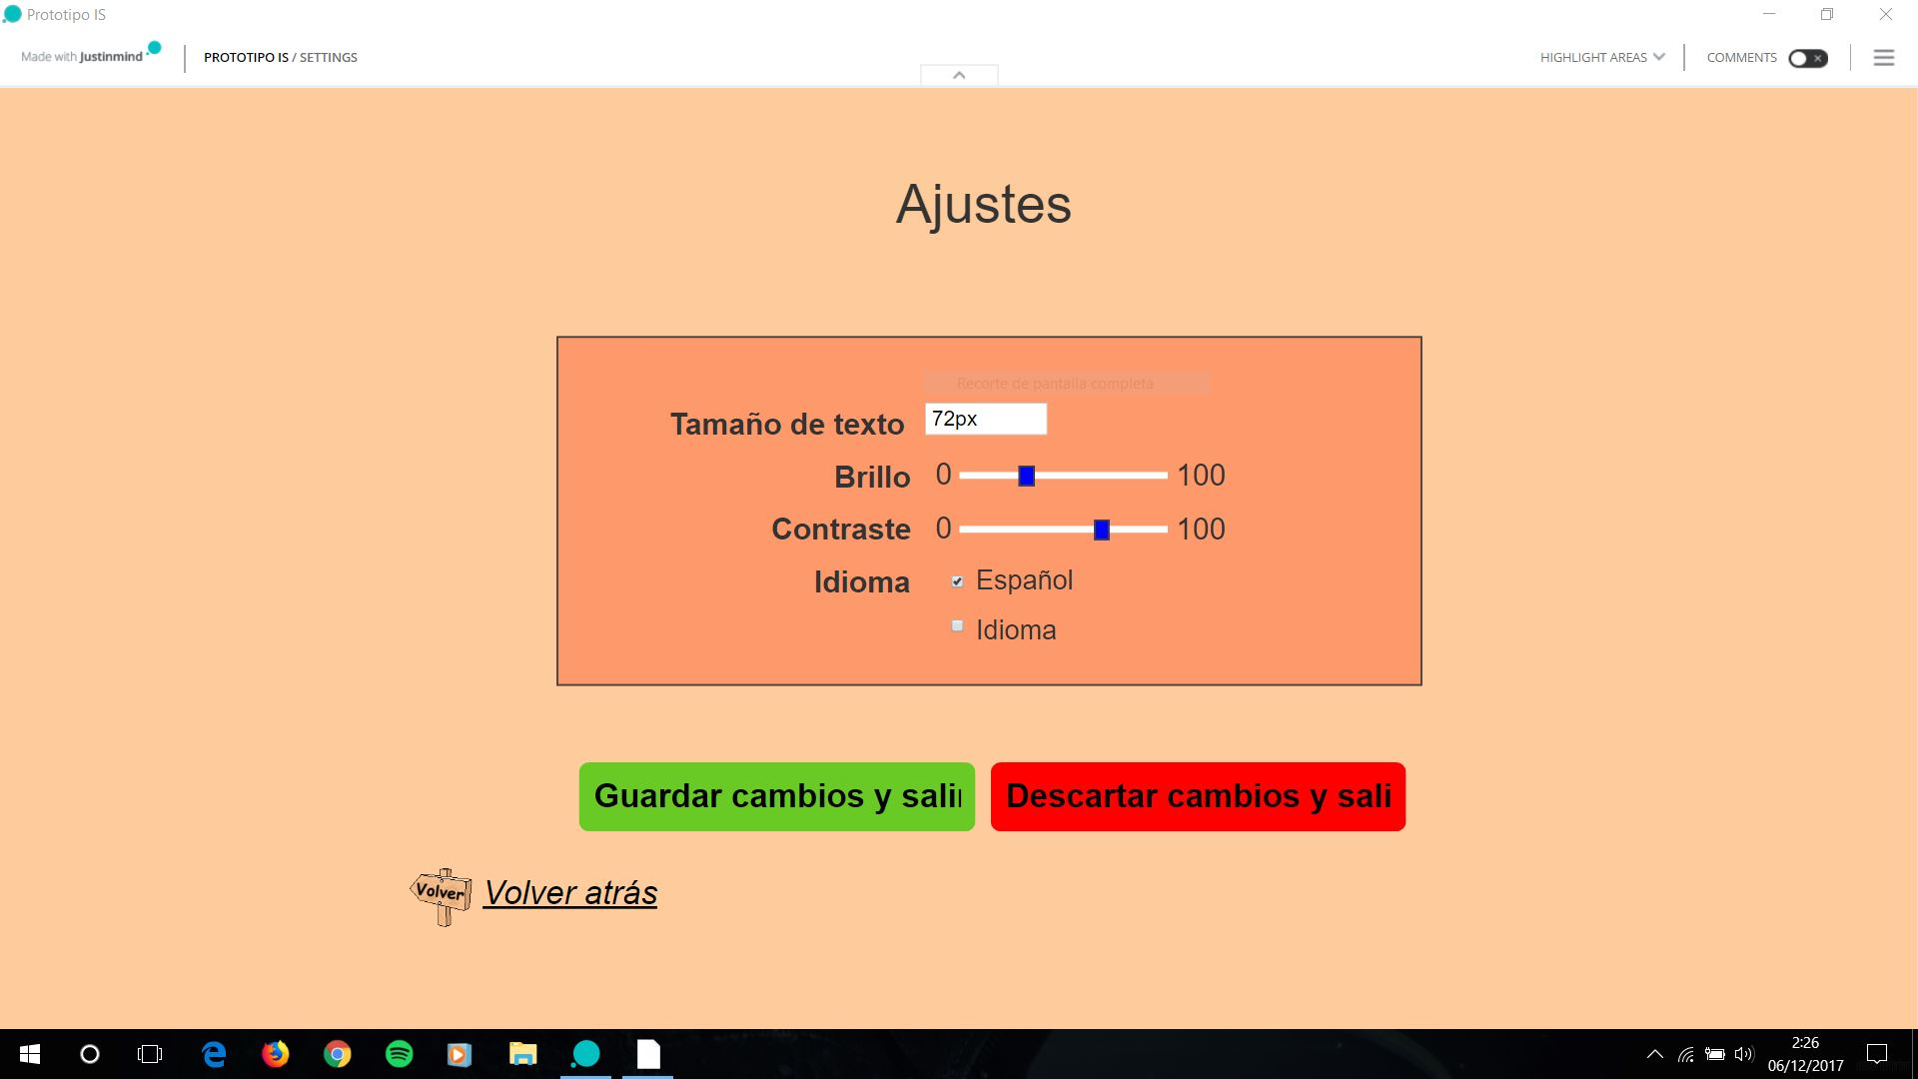
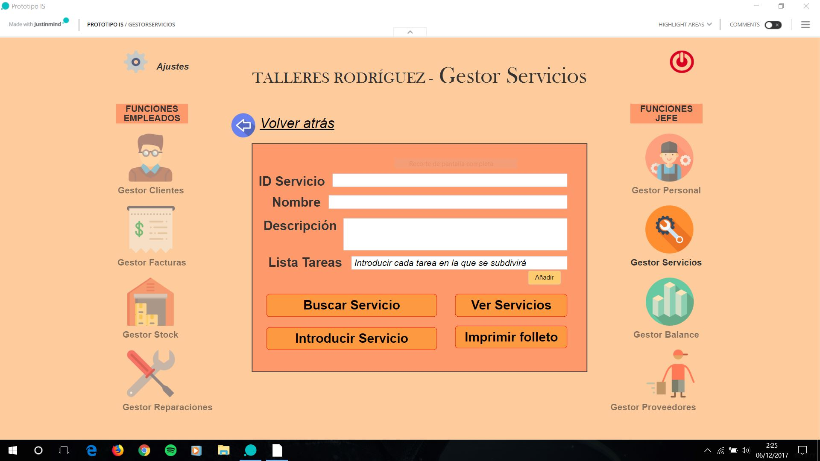
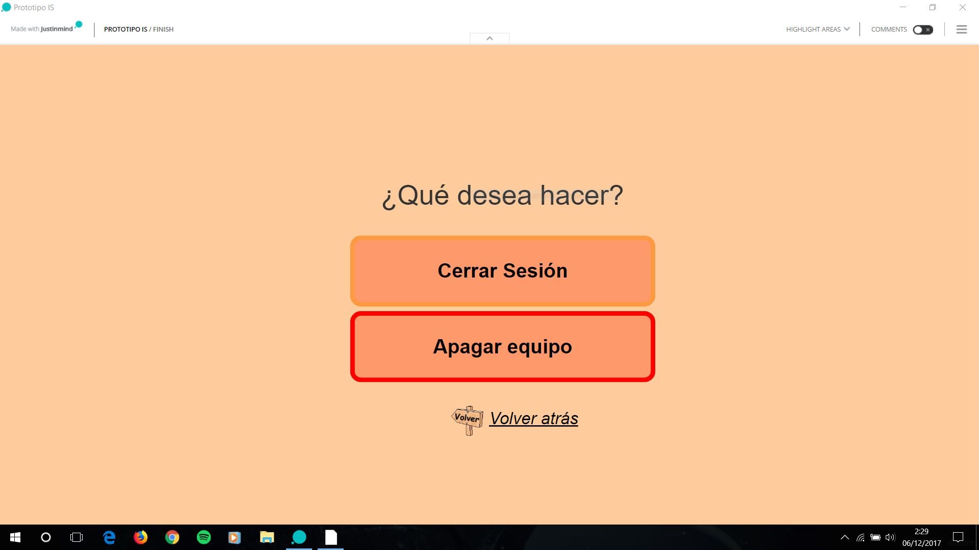
Software Development - Interface

Slide 20

Handbooks
User Manual
Programmer’s Manual

Slide 21
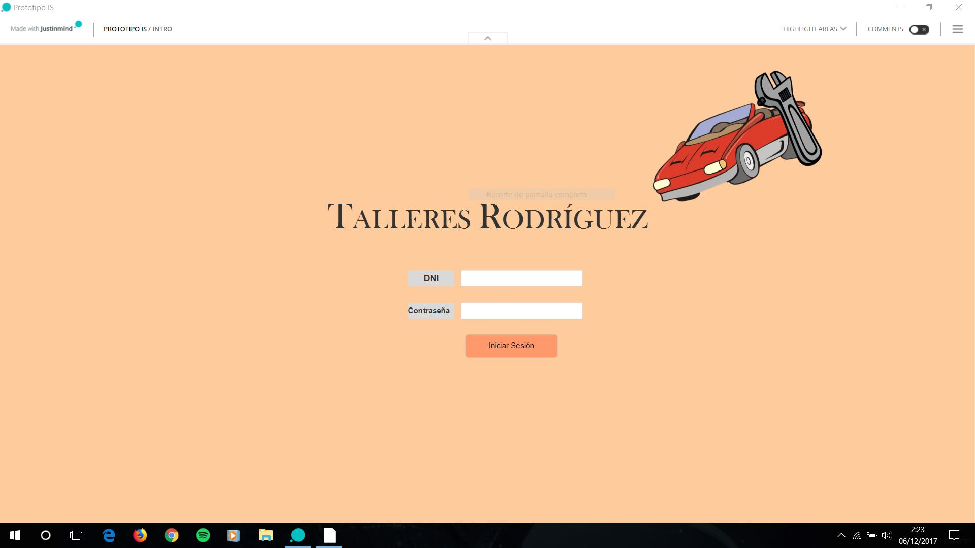
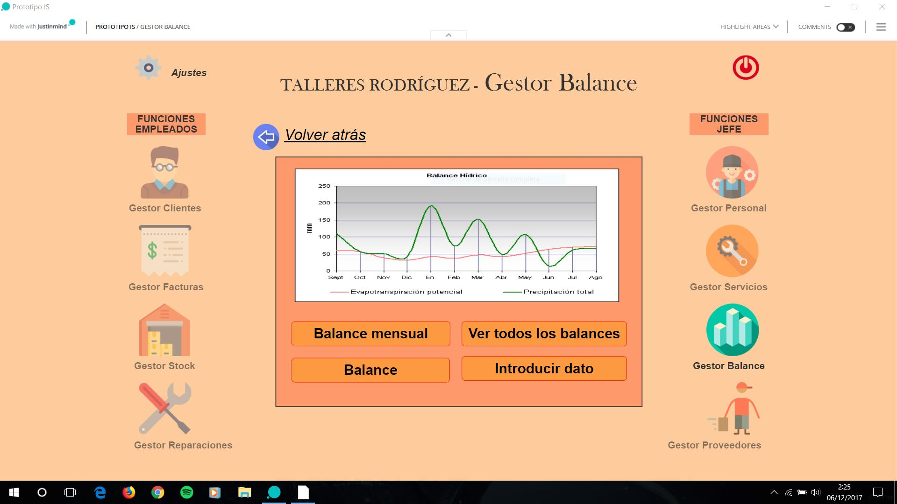
Handbooks
User manual
Requirements
To install the application in all the computers
How to use the interface

Slide 22

Handbooks
Programmer’s manual
Free Software
Security methods
Devices used

